Slide 1
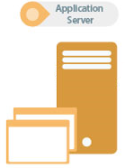

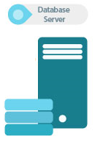


Typical Monolith Application
Load Balancer
Message Queue

Slide 2
Software Deployments
Software deployment includes all the process required for preparing a software application to run and operate in a specific environment.
It involves installation, configuration, testing and making changes to optimize the performance of the software.
Types of deployments ?
Recreate: Version A is terminated then version B is rolled out.
Ramped (also known as rolling-update or incremental): Version B is slowly rolled out and replacing version A.
Blue/Green: Version B is released alongside version A, then the traffic is switched to version B.
Canary: Version B is released to a subset of users, then proceed to a full rollout.
DEV
QA
PERF
STAGE
PROD

Slide 3
Streamline Deployments using Docker
Compose the application into Docker Images
Break the application components into individual containers
Split the data that’s shared between services into volumes
Separate responsibilities so that each containers runs only one component/executable
Store the changeable data (configurations, logs) as Volumes so that they are mounted on various containers
Modern development’s primary focus is often based around three central concepts:
efficiency
reliability
repeatability

Slide 4
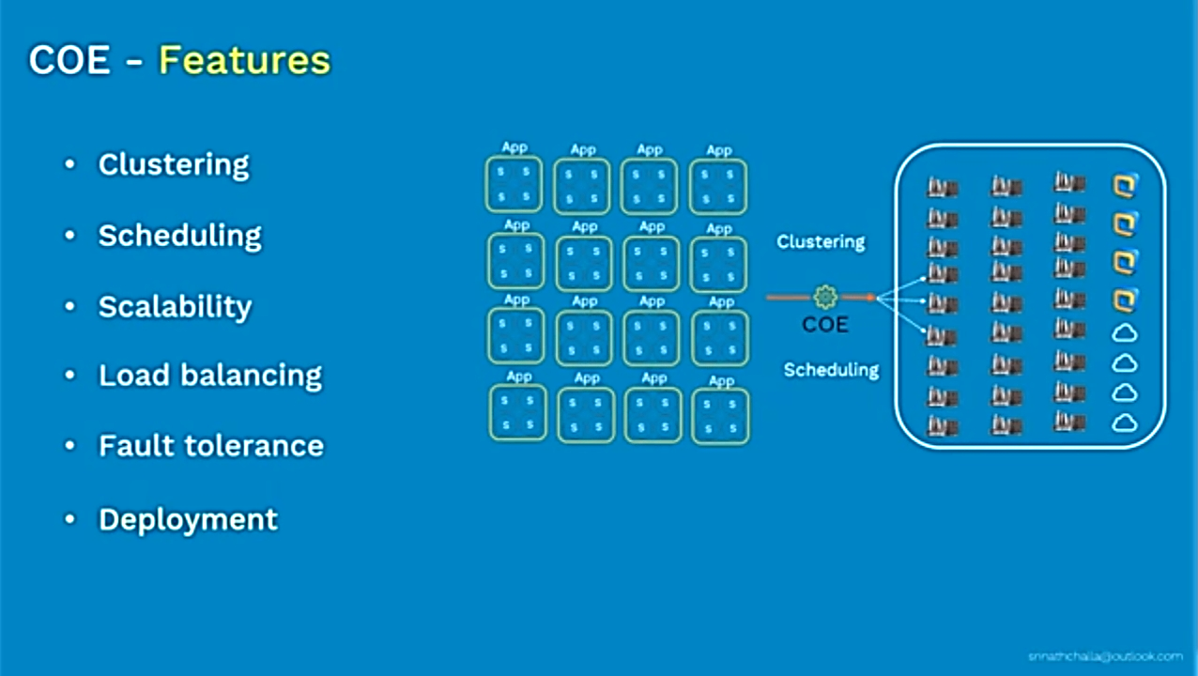
Need for a Container Orchestration System?

Slide 5
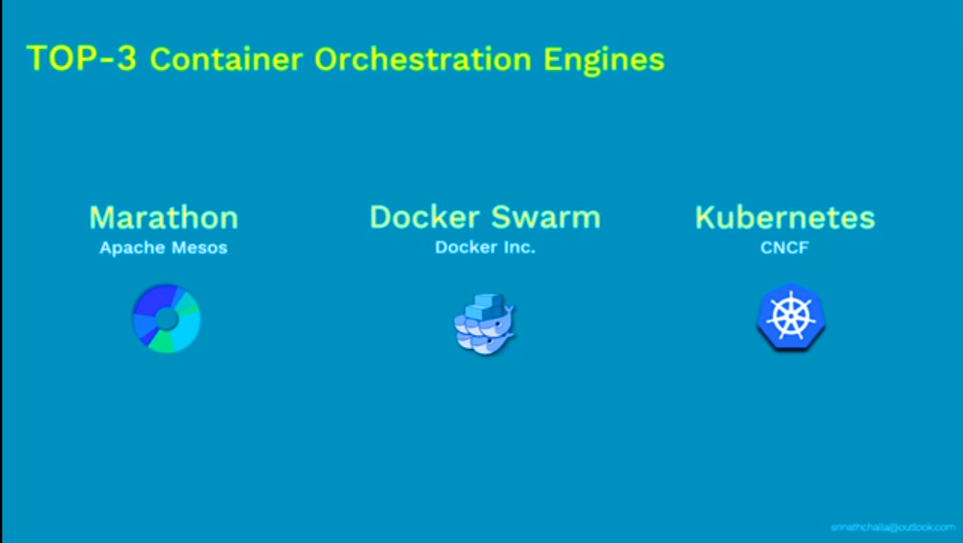

Slide 6
What is Kubernetes?
K8s is an open-source container-orchestration system for automating deployment, scaling and management of containerized applications across clusters of hosts.
At a high level, it takes multiple Containers running on different hosts and lets you use them together.
Run containers anywhere on clusters of physical, virtual machines and cloud infrastructure.
Start, stop, update, and manage a cluster of machines running containers in a consistent and maintainable way.
A declarative & imperative language for launching containers.
We will define the desired state, K8s will monitor the current actual state and synchronize it with the desired state, What we want.
K8s provides the tooling to manage the when, where, and how many of the application stack and its components.
K8s also allows finer control of resource usage, such as CPU, memory, and disk space across our infrastructure.

Slide 7
Features of Kubernetes
Following are some of the important features of Kubernetes:
Continuous development, integration and deployment
Containerized infrastructure
Application-centric management
Auto-scalable infrastructure
Environment consistency across development testing and production
Loosely coupled infrastructure, where each component can act as a separate unit
Higher density of resource utilization

Slide 8
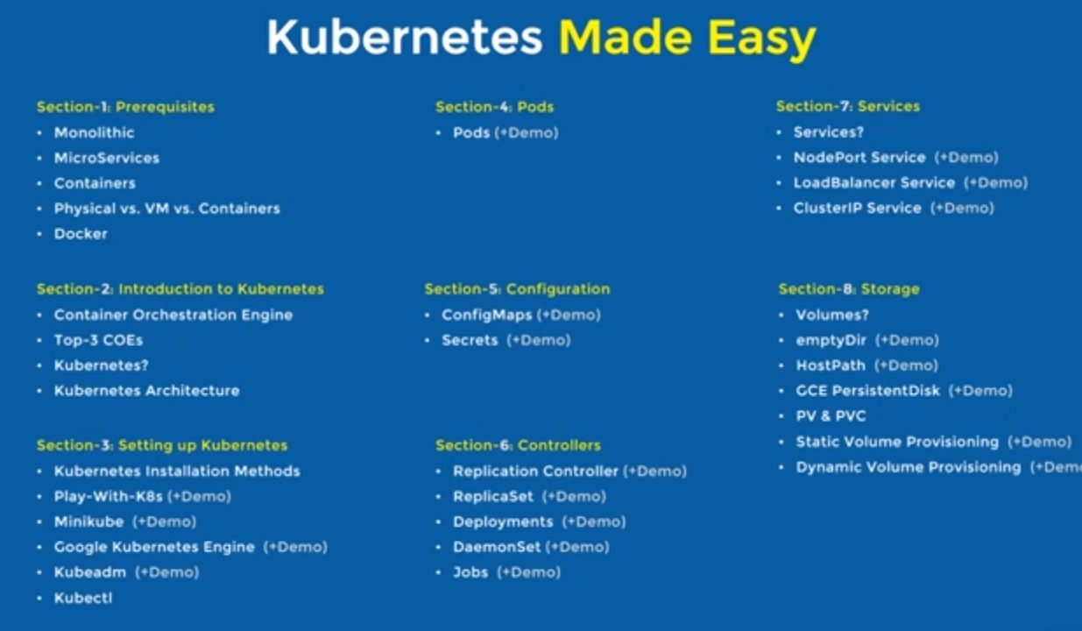

Slide 9
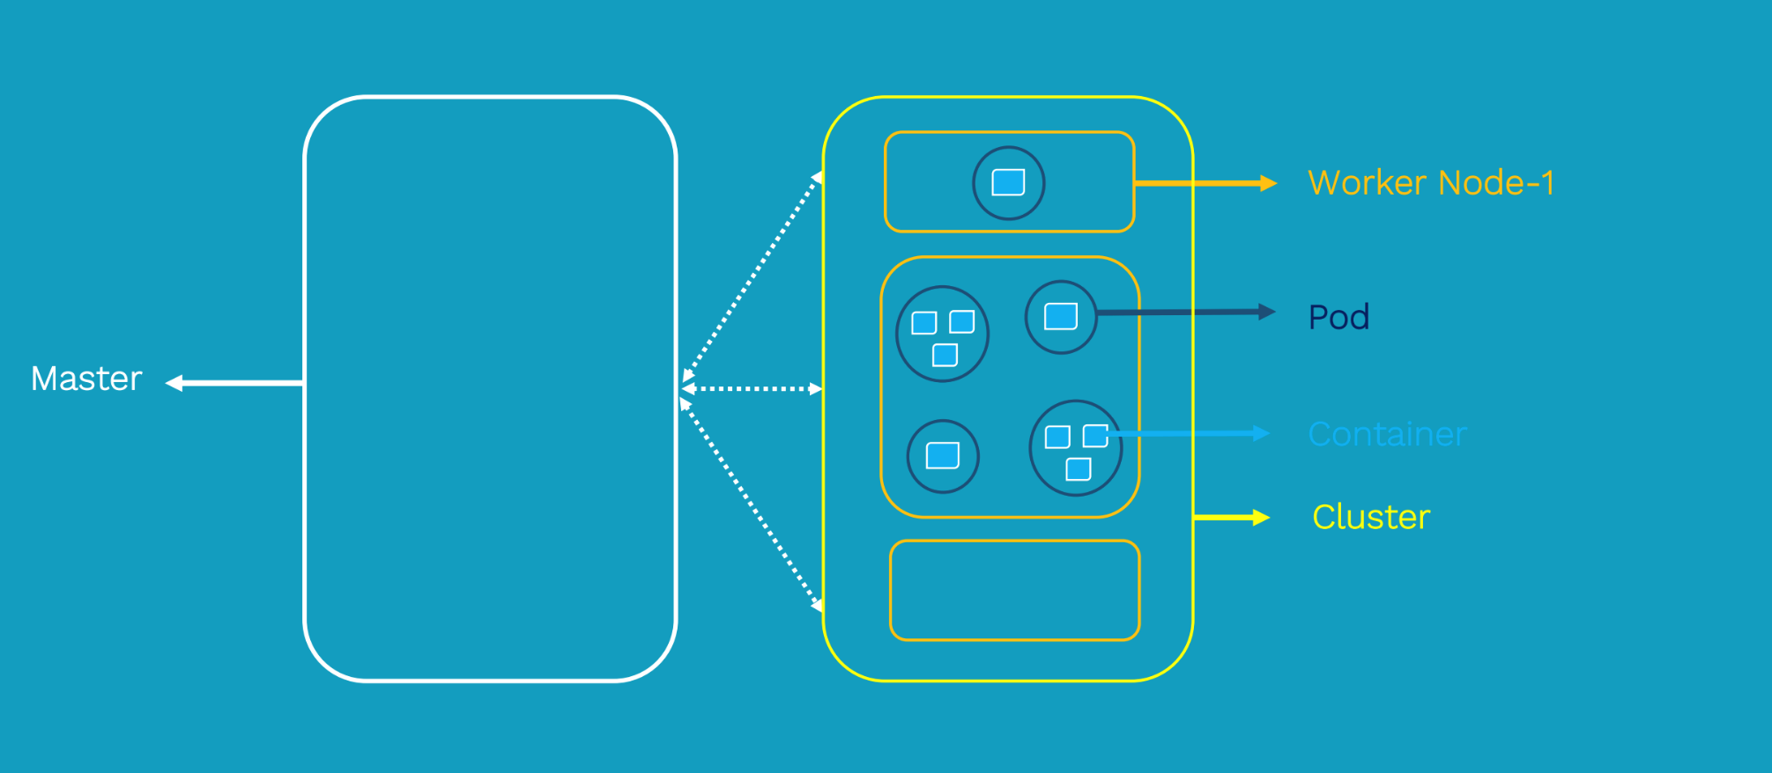
Overview

Slide 10
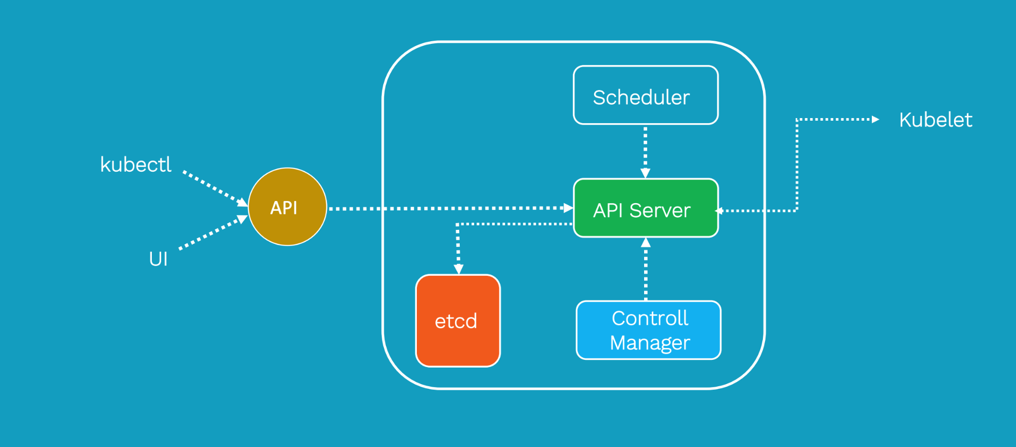
Kubernetes Master

Slide 11
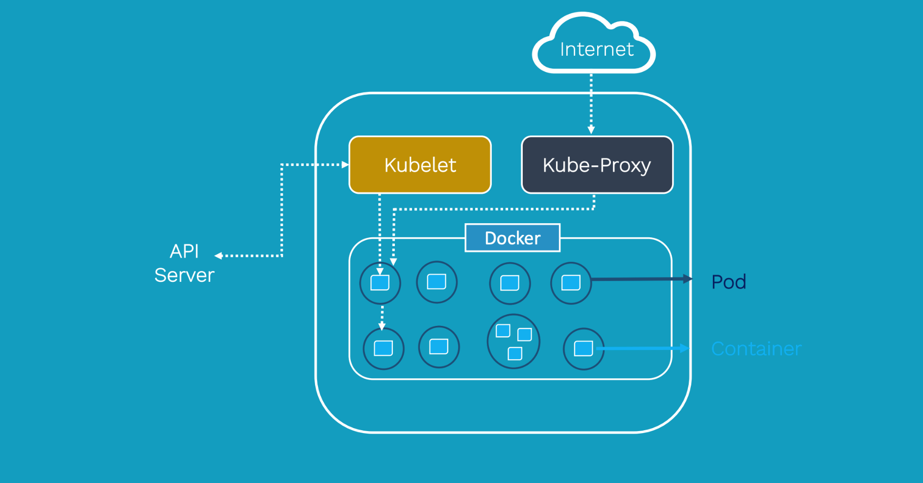
Kubernetes Worker Node

Slide 12
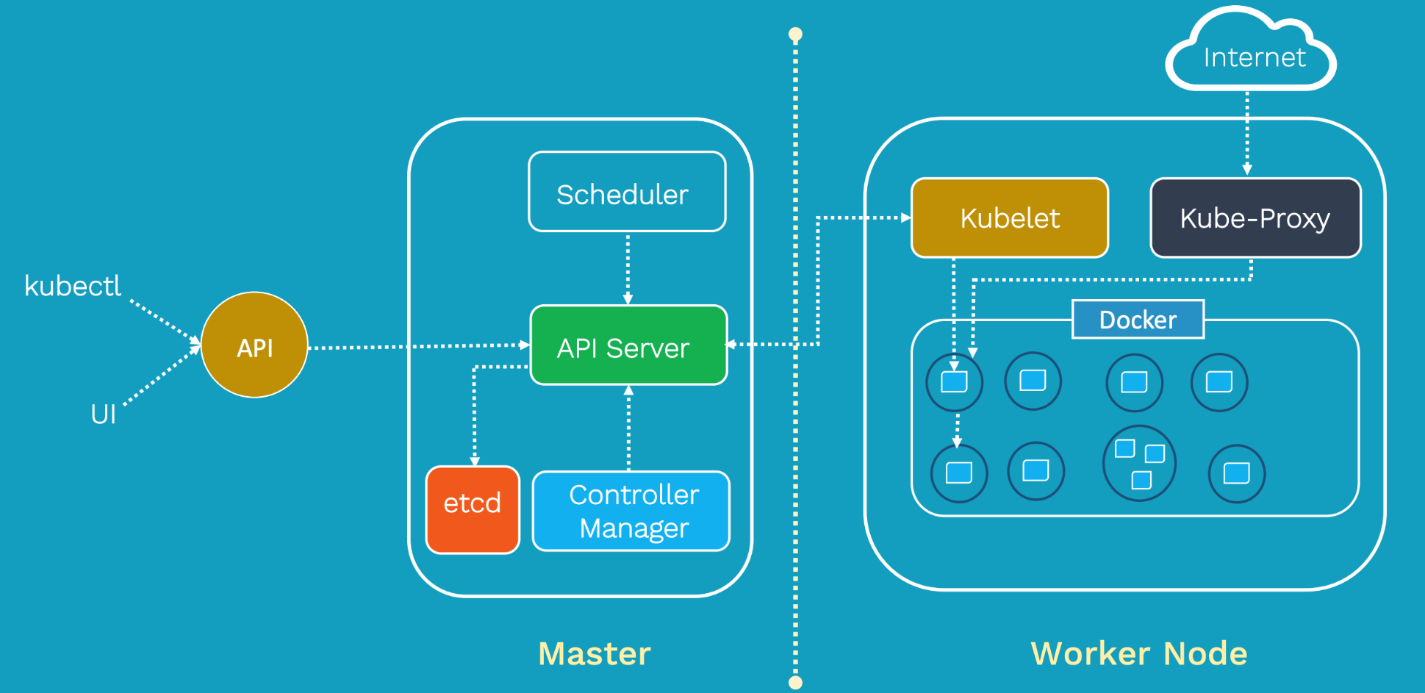
Kubernetes Architecture Diagram

Slide 13

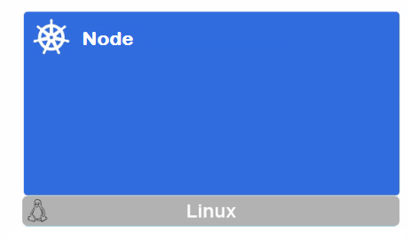
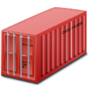
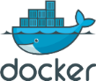
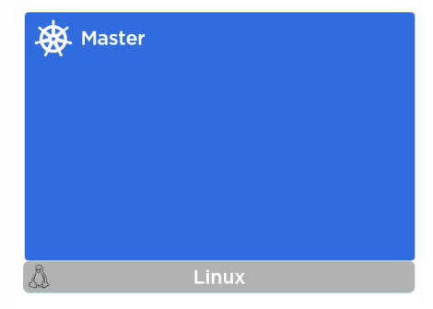

Kubernetes Architecture
Docker Registry
UI
User
Interface
API
CLI
Command
Line
Notes:
What is API?
https://www.mulesoft.com/resources/api/what-is-an-api
https://www.upwork.com/hiring/development/intro-to-apis-what-is-an-api/

Slide 14




Kubernetes Master
Master is the brain of the cluster
Master orchestrates the cluster
We will access the master to initiate changes and
not the nodes directly
Master consists of these components:
kube-apiserver
kube-scheduler
kube-controller-manager
etcd
All the master components are set up on a single host
Multiple masters are configured for High-Availability
We can communicate to the master node via the CLI, the GUI (Dashboard), or via APIs
Server
Scheduler
Controller
Keystore

Slide 15

kube-apiserver
Frontend to the cluster
Our communication to cluster happens only through apiserver
Maintains RESTful web services for querying and defining our desired cluster and workload state by consuming the YAML content
etcd
Acts as the memory for the Brain(master)
It stores the configuration information i.e Cluster state
It is a high availability key value store that can be distributed among multiple nodes
It is accessible only by Kubernetes API server
Server

Slide 16
kube-controller-manager
Watches over the state of the cluster and their job is to steer the cluster into the desired state at any time
If actual state is different, scheduler will be invoked to ensure the correct number of containers are running
Responsible for noticing and responding when nodes go down
Responsible for maintaining the correct number of Instances specified
Examples of controllers that ship with Kubernetes today are the replication controller, endpoints controller, namespace controller, and serviceaccounts controller.
kube-scheduler
Scheduler works with the API server to schedule workloads on the nodes.
It uses different node for matching the desired state and spreads pods across the nods running in cluster.
Controller
Scheduler

Slide 17

What is an API? (Application Programming Interface)
API is a software intermediary that allows two applications to talk to each other. Each time you use an app like Facebook, send an instant message, or check the weather on your phone, you’re using an API
RESTful API is a method of allowing communication between a web-based client and server

Slide 18

Kubernetes Nodes

Slide 19
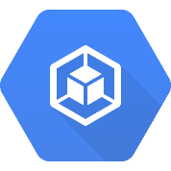


Kubernetes Nodes(Minions)
Nodes are the machines in which Pods/Container run
Node consists of these components:
kubelet
kube-proxy
Container engine
These components, receive workloads to execute, and update the cluster on their status
Kubelet
Proxy
Engine
To run and manage a container's lifecycle, we need a container runtime on the worker node. Some examples of container runtimes are:
containerd
rkt
lxd.

Slide 20
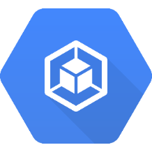
kubelet
The main kubernetes agent
Interacts with the API server on the Master
Registers the Node with the cluster
Updates the workloads that have been invoked by the scheduler:
Mount Volumes
Run containers
Report the status of the node
Run container liveness probe

Slide 21
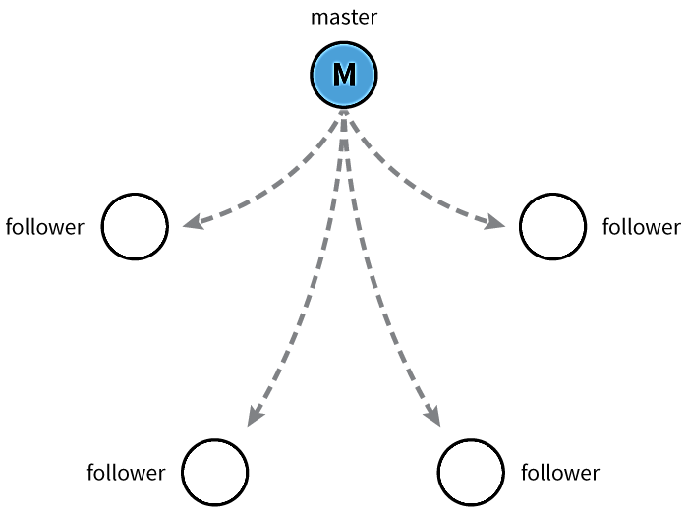
kubelet
Kubernetes uses etcd to store the cluster state & etcd is a distributed key-value store based on the Raft Consensus Algorithm.
Raft allows a collection of machines to work as a coherent group that can survive the failures of some of its members
At any given time, one of the nodes in the group will be the master, and the rest of them will be the followers
Any node can be treated as a master.

Slide 22
Kube-proxy
Instead of connecting directly to Containers to access the applications, we use a logical construct called a Service as a connection endpoint.
A Service groups related Pods and, when accessed, load balances to them
Proxy which runs on each worker node and listens to the API server, sets up the routes so that it can reach to it

Slide 23
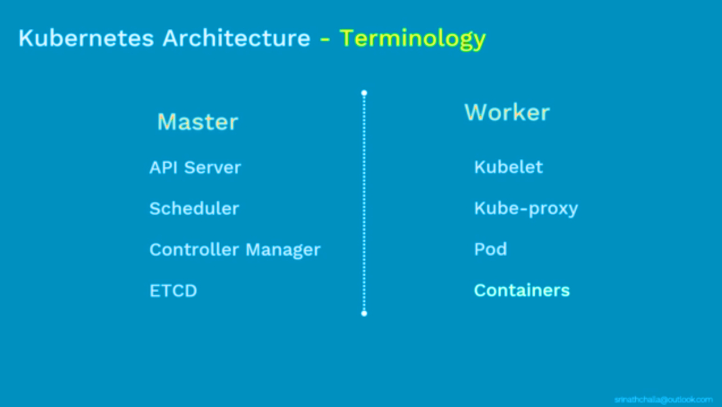

Slide 24
Kubernetes Objects

Slide 25
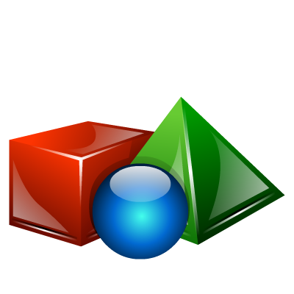
Kubernetes Objects
Kubernetes uses Objects to represent the state of your cluster
What containerized applications are running (and on which nodes)
The resources available to those applications
The policies around how those applications behave, such as restart policies, upgrades, and fault-tolerance
Once you create the object, the Kubernetes system will constantly work to ensure that object exists and maintain cluster’s desired state
Every Kubernetes object includes two nested fields that govern the object’s configuration: the object spec and the object status
The spec, which we provide, describes your desired state for the object–the characteristics that you want the object to have.
The status describes the actual state of the object, and is supplied and updated by the Kubernetes system.
All objects in the system are identified by a Unique Name and a UID.
Notes:
Objects has a state in which we define properties and its value

Slide 26
Kubernetes Objects
The basic Kubernetes objects include:
Pod
Service
Volume
Namespace
In addition, Kubernetes contains a number of higher-level abstractions called Controllers. Controllers build upon the basic objects, and provide additional functionality:
ReplicaSet
Deployment
StatefulSet
DaemonSet
Job

Slide 27
Kubernetes Objects Management
The kubectl command-line tool supports several different ways to create and manage Kubernetes objects
Declarative is about describing what you're trying to achieve, without instructing how to do it
Imperative explicitly tells "how" to accomplish it
Management technique | Operates on | Recommended environment
Imperative commands | Live objects | Development projects
Declarative object configuration | Individual files (yaml/json) | Production

Slide 28
Kubernetes Configuration
All-in-One Single-Node Installation
With all-in-one, all the master and worker components are installed on a single node. This is very useful for learning, development, and testing. This type should not be used in production. Minikube is one such example, and we are going to explore it in future chapters.
Single-Node etcd, Single-Master, and Multi-Worker Installation
In this setup, we have a single master node, which also runs a single-node etcd instance. Multiple worker nodes are connected to the master node.
Single-Node etcd, Multi-Master, and Multi-Worker Installation
In this setup, we have multiple master nodes, which work in an HA mode, but we have a single-node etcd instance. Multiple worker nodes are connected to the master nodes.

Slide 29
Infrastructure for Kubernetes Installation
Localhost Installation - Minikube
On-Premise Installation - Vagrant, Vmware, KVM
Cloud Installation
Google Kubernetes Engine (GKE)
Azure Container Service (AKS)
Amazon Elastic Container Service for Kubernetes (EKS)
OpenShift
Platform9
IBM Cloud Container Service
Kubernetes Installation Tools/Resources:
Kubeadm
Kubespray
kops

Slide 30
Setting Up a Single-Node Kubernetes Cluster with Minikube
Install Docker
$ sudo apt update && apt -y install docker.io
Install kubectl
$ curl -LO https://storage.googleapis.com/kubernetes-release/release/$(curl -s https://storage.googleapis.com/kubernetes-release/release/stable.txt)/bin/linux/amd64/kubectl
$ chmod +x ./kubectl && sudo mv ./kubectl /usr/local/bin/kubectl
Install Minikube
$ curl -Lo minikube https://storage.googleapis.com/minikube/releases/latest/minikube-linux-amd64
$ chmod +x minikube && sudo mv minikube /usr/local/bin/
Start Minikube
$ yum install conntrack
$ minikube start --vm-driver=none
$ minikube status
Notes:
$ Minikube version

Slide 31
Kubectl Usage
$ kubectl [COMMAND] [TYPE] [NAME] [flags]
COMMAND: Specifies the operation that you want to perform on one or more resources, for example create, apply, get, describe, delete, exec …
TYPE: Specifies the resource type i.e nodes, pods, services, rc, rs …
NAME: Specifies the name of the resource
flags: Optional arguments
$ kubectl version
$ kubectl get node
$ kubectl describe nodes <nodename>

Slide 32
Pods

Slide 33
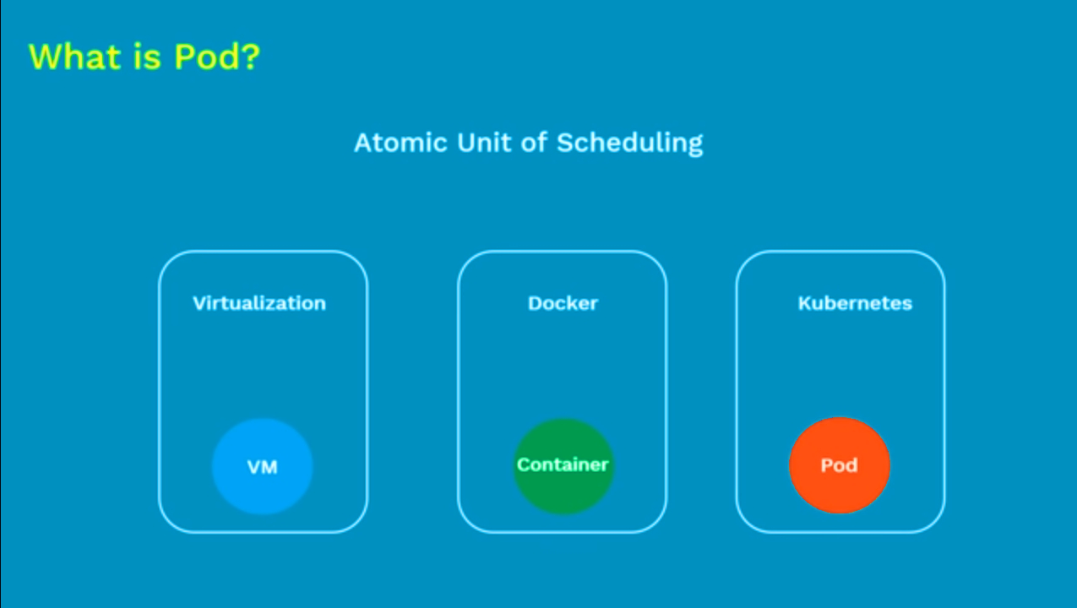

Slide 34
POD
Pod
A Pod is the smallest and simplest unit in the Kubernetes object model that you create or deploy.
A Pod represents a running process on your cluster.
A Pod encapsulates an application container, storage resources, a unique network IP, and options that govern how the container(s) should run
Kubernetes manages the Pods rather than the containers directly.
Pods in a Kubernetes cluster can be used in two main ways:
Pods that run a single container - common use case
Pods that run multiple containers that need to work together

Slide 35
POD
Pod
Each Pod is assigned a unique IP address.
Every container in a Pod shares the IP address and network ports.
Containers inside a Pod can communicate with one another using localhost.
All containers in the Pod can access the shared volumes, allowing those containers to share data.
Kubernetes scales pods and not containers

Slide 36
Understanding Pods
Pod
When a Pod gets created, it is scheduled to run on a Node in your cluster.
The Pod remains on that Node until the process is terminated, the pod object is deleted, the pod is evicted for lack of resources, or the Node fails.
If a Pod is scheduled to a Node that fails, or if the scheduling operation itself fails, the Pod is deleted
If a node dies, the pods scheduled to that node are scheduled for deletion, after a timeout period.
A given pod (UID) is not “rescheduled” to a new node; instead, it will be replaced by an identical pod, with even the same name if desired, but with a new UID
Volumes in a pod will exists as long as that pod (with that UID) exists. If that pod is deleted for any reason, volume is also destroyed and created as new on new pod
Kubernetes uses a Controller, that handles the work of managing the Pod instances.
A Controller can create and manage multiple Pods, handling replication, rollout and providing self-healing capabilities

Slide 37
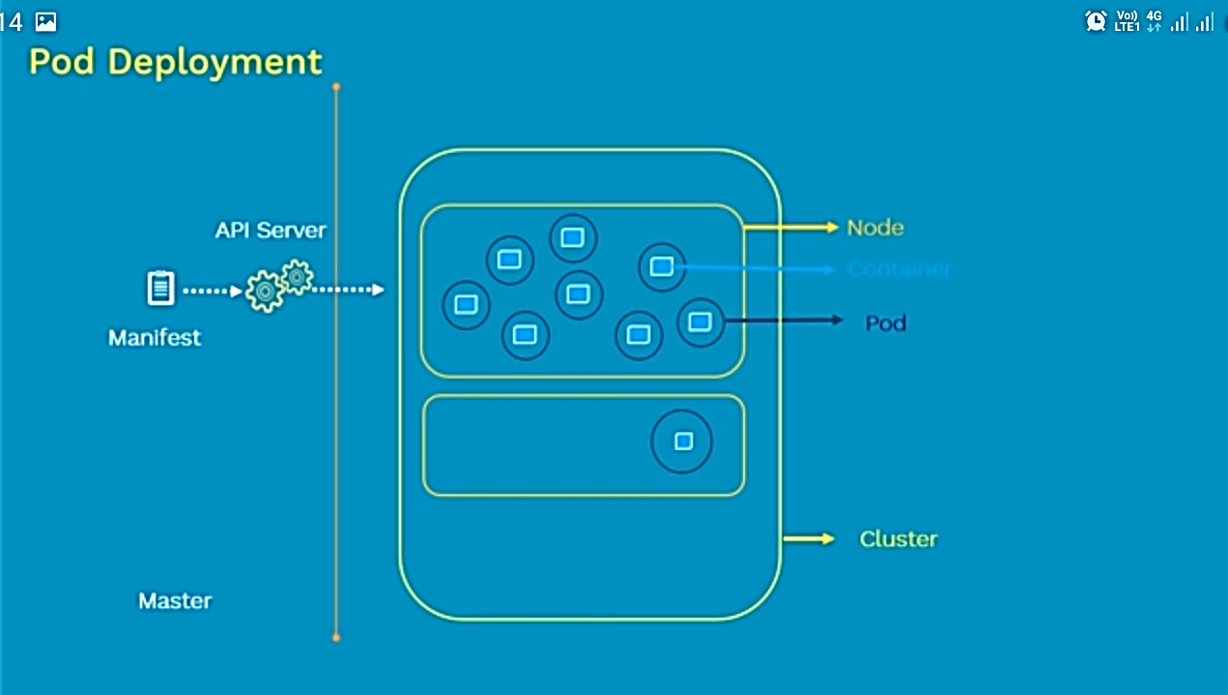

Slide 38
Kubernetes YAML Basics
env
resources
volumeMounts
livenessProbe
readinessProbe
livecycle
terminationMessagePath
imagePullPolicy - Always
securityContext
stdin
stdinOnce
tty
API: version
Kind: object we are trying to achieve
metadata: name and label
spec: set of data which defines the desired state for the resource
-- properties you can set for a Container:
name
image
command
args
workingDir
ports

Slide 39
Pod Single Container Pod - Example1: pod1.yml
kind: Pod # Object Type
apiVersion: v1 # API version
metadata: # Set of data which describes the Object
name: testpod # Name of the Object
spec: # Data which describes the state of the Object
containers: # Data which describes the Container details
- name: c00 # Name of the Container
image: ubuntu # Base Image which is used to create Container
command: ["/bin/bash", "-c", "while true; do echo Hello; sleep 5 ; done"]
restartPolicy: Never # Defaults to Always
Always means that the container will be restarted even if it exited with a zero exit code
OnFailure means that the container will only be restarted if it exited with a non-zero exit code
Never means that the container will not be restarted regardless of why it exited.

Slide 40
Create or update an Object
$ kubectl create -f pod1.yml (or) $ kubectl apply -f pod1.yml
Get the list of the pod objects available
$ kubectl get pods
$ kubectl get pods -o wide
$ kubectl get pods --all-namespaces
Get the details of the pod object
$ kubectl describe pod <podname>
Get running logs from the container inside the pod object
$ kubectl logs -f <podname>
$ kubectl logs -f <podname> -c <containername>

Slide 41
Pod Annotate - Example2: podannotate.yml
kind: Pod
apiVersion: v1
metadata:
name: testpod2
annotations: # comments to describe the Object usage
description: our first testpod
spec:
containers:
- name: c00
image: ubuntu
tty: true
stdin: true
command: ["/bin/bash", "-c", "while true; do echo Hello; sleep 5 ; done"]

Slide 42
$ kubectl apply -f podannotate.yml
Run OS commands in an existing pod (1 container pod)
$ kubectl exec <podname> -- <OScmd>
$ kubectl exec testpod2 -- hostname -i
Run OS commands in an existing container( multi container pod)
$ kubectl exec <podname> -c <containername> -- <OScmd>
Attach to the running container interactively
$ kubectl exec <podname> -i -t -- /bin/bash (or)
$ kubectl attach <podname> -i
Delete a Pod
$ kubectl delete pods <podname> (or)
$ kubectl delete -f <YAML>

Slide 43
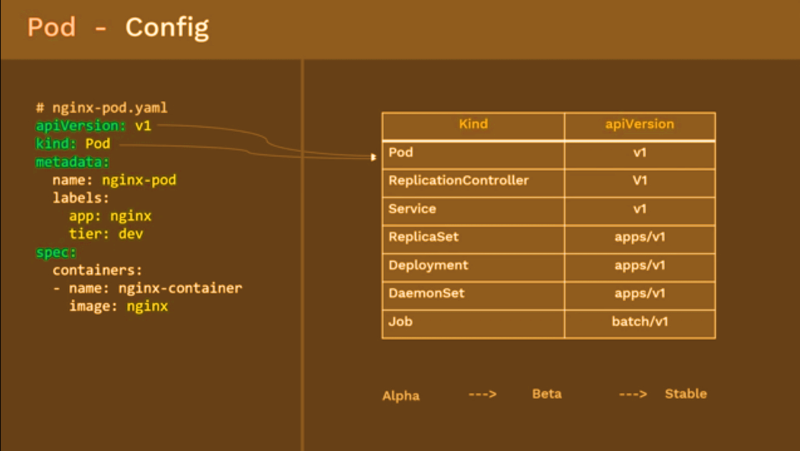

Slide 44
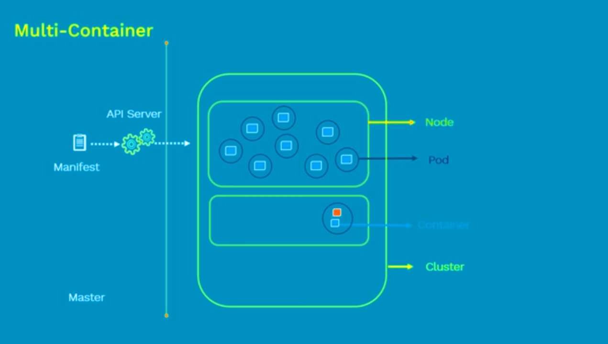

Slide 45
Pod Multi-container Pod - Example3: podmulcont.yml
kind: Pod
apiVersion: v1
metadata:
name: testpod3
spec:
containers:
- name: c00
image: ubuntu
command: ["/bin/bash", "-c", "while true; do echo Hello; sleep 5 ; done"]
- name: c01
image: ubuntu
command: ["/bin/bash", "-c", "while true; do echo Hello-Friends; sleep 5 ; done"]
$ kubectl apply -f podmulcont.yml
$ kubectl logs -f testpod3 -c c00
$ kubectl logs -f testpod3 -c c01

Slide 46
Pod Environment Variables – Example4: podenv.yml
kind: Pod
apiVersion: v1
metadata:
name: environments
spec:
containers:
- name: c00
image: ubuntu
command: ["/bin/bash", "-c", "while true; do echo Hello; sleep 5 ; done"]
env: # List of environment variables to be used inside the pod
- name: <Name of the environment variable>
value: <value>
$ kubectl apply -f podenv.yml
$ kubectl exec environments -- env
$ kubectl logs -f environments

Slide 47
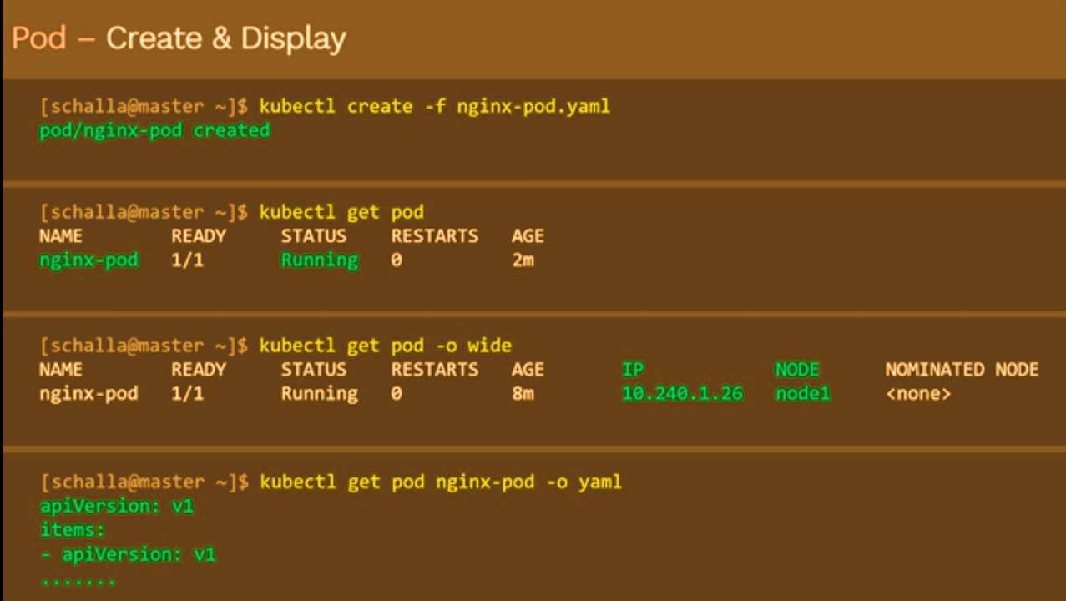

Slide 48
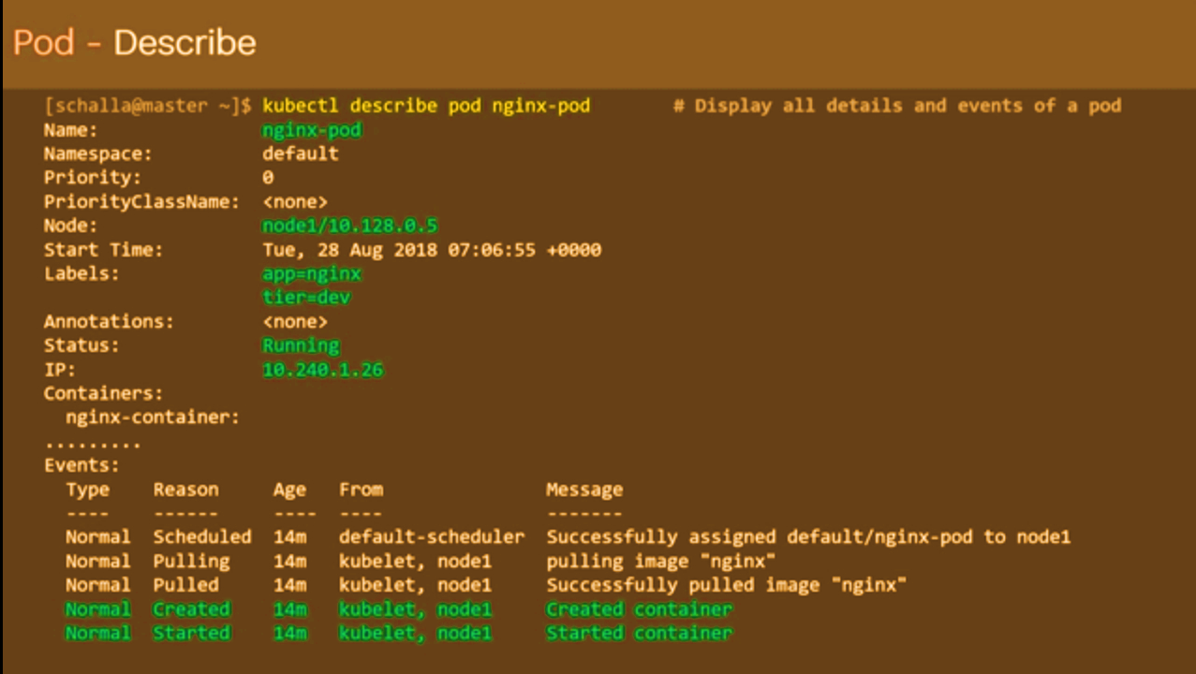

Slide 49
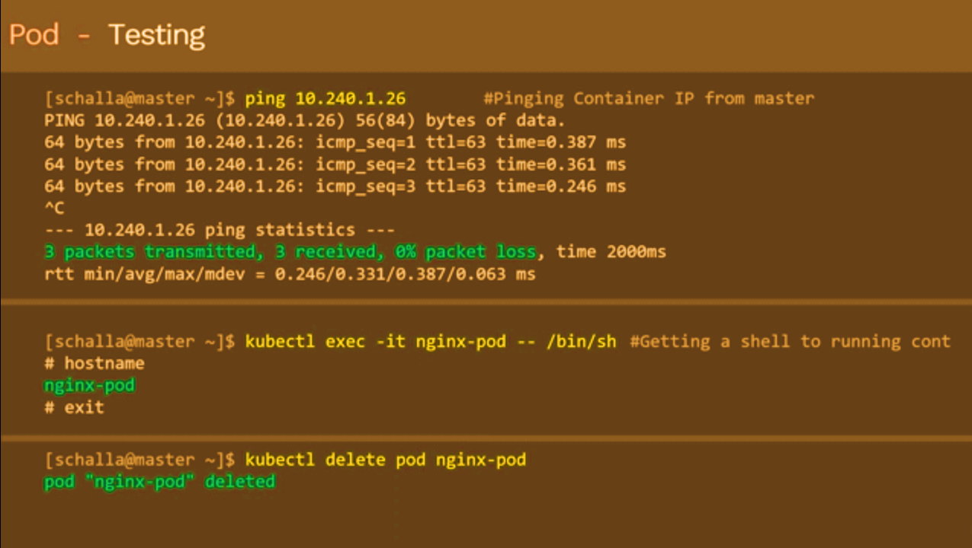

Slide 50
Pod Life Cycle

Slide 51
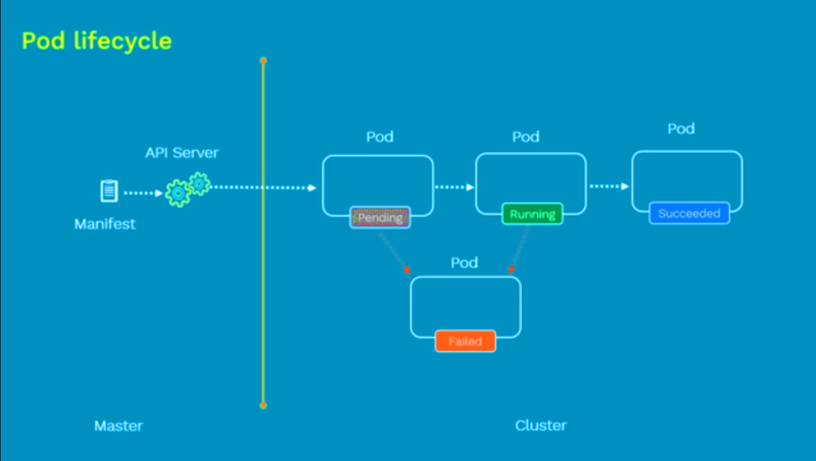

Slide 52
Pod Phases
The phase of a Pod is a simple, high-level summary of where the Pod is in its lifecycle.
Here are the possible values for phase:
Pod
Pod
Pod
Pod
Pending
Running
Succeeded
Failed
Pod
Pod
Completed
Unknown

Slide 53
Pending:
The Pod has been accepted by the Kubernetes system, but its not running
one or more of the Container images is still downloading
If the pod cannot be scheduled because of resource constraints
Running:
The Pod has been bound to a node
All of the Containers have been created
At least one Container is still running, or is in the process of starting or restarting
Succeeded:
All Containers in the Pod have terminated in success, and will not be restarted
Pod
Pod
Pod

Slide 54
Pod
Failed:
All Containers in the Pod have terminated, and at least one Container has
terminated in failure.
The Container either exited with non-zero status or was terminated by the system
Unknown:
State of the Pod could not be obtained
Typically due to an Error in Network or communicating with the host of the Pod
Completed:
The pod has run to completion as there’s nothing to keep it running eg. Completed Jobs
Pod
Pod

Slide 55
Pod Conditions
A Pod has a PodStatus, which has an array of PodConditions through which the Pod has or has not passed.
Using ‘kubectl describe pod PODNAME’ you can get the condition of a Pod
These are the possible types:
PodScheduled: the Pod has been scheduled to a node
Ready: the Pod is able to serve requests and will be added to the load balancing pools of all matching Services
Initialized: all init containers have started successfully
Unschedulable: the scheduler cannot schedule the Pod right now, for example due to lacking of resources or other constraints
ContainersReady: all containers in the Pod are ready

Slide 56
Container States
Once Pod is assigned to a node by scheduler, kubelet starts creating containers using container runtime
Using ‘kubectl get pod PODNAME –o yaml’ state is displayed for each container within that Pod
There are three possible states of containers:
Waiting: A container in Waiting state still indicates that its pulling images, applying Secrets, etc
Running: Indicates that the container is executing without issues. Once a container enters into Running
Terminated: Indicates that the container completed its execution and has stopped running.A container enters into this when it has successfully completed execution or when it has failed for some reason

Slide 57
Pod Lifecycle
Initial Delay Sec
Readiness Probe
Liveness Probe
Post Start Hook
Pre Start Hook
Type Status
Initialized True
Ready True
PodScheduled True
Init Container
Main Container
Type Status
Initialized False
Ready False
PodScheduled True
Type Status
Initialized True
Ready False
PodScheduled True

Slide 58
Labels & Selectors

Slide 59
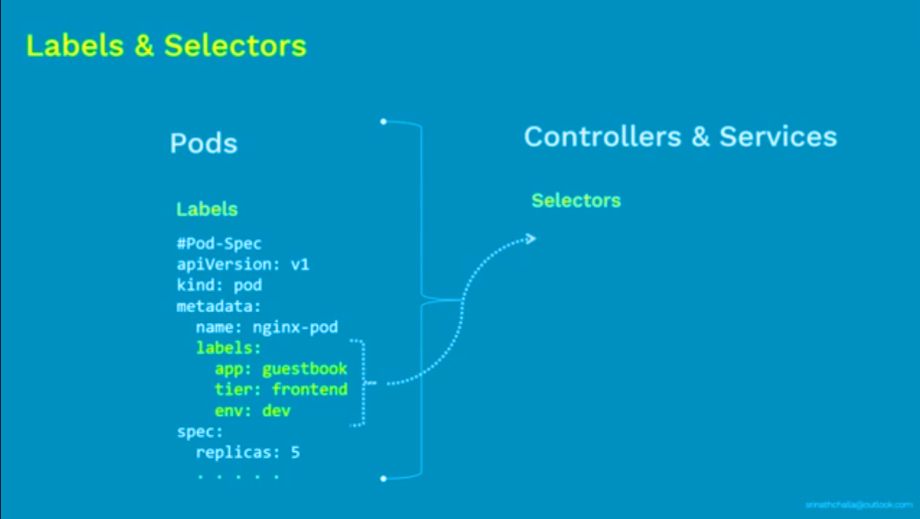

Slide 60
Labels & Selectors
Labels are the mechanism you use to organize Kubernetes objects
A label is a key-value pair without any predefined meaning that can be attached to the Objects
Labels are similar to Tags in AWS or Git where you use a name to quick reference
So you’re free to choose labels as you need it to refer an environment which is used for Dev or Testing or Production, refer an product group like DepartmentX, DepartmentY
Multiple labels can be added to a single object

Slide 61
Pod Labels – Example6: podlabels.yml
kind: Pod
apiVersion: v1
metadata:
name: labelspod
labels: # Specifies the Label details under it
<app>: <test>
<env>: <prd>
spec:
containers:
- name: c00
image: ubuntu
command: ["/bin/bash", "-c", "while true; do echo Hello; sleep 5 ; done"]

Slide 62
$ kubectl apply -f podlabels.yml
To see list of pods available with details of Labels if any attached to it
$ kubectl get pods --show-labels
Add a label to an existing pod
$ kubectl label pods <podname> <labelkey>=<value>
List pods matching a label
$ kubectl get pods -l <label>=<value>
We can also delete pods based on label selection
$ kubectl get pods -l <label>=<value>

Slide 63
Label Selectors
Unlike name/UIDs, Labels do not provide uniqueness, as in general, we can expect many objects to carry the same label
Once labels are attached to an object, we would need filters to narrow down and these are called as Label Selectors
The API currently supports two types of selectors: equality-based and set-based
A label selector can be made of multiple requirements which are comma-separated
Equality-based requirement: ( = , != )
environment = production
tier != frontend
Set-based requirement: (in,notin and exists)
environment in (production, qa)
tier notin (frontend, backend)

Slide 64
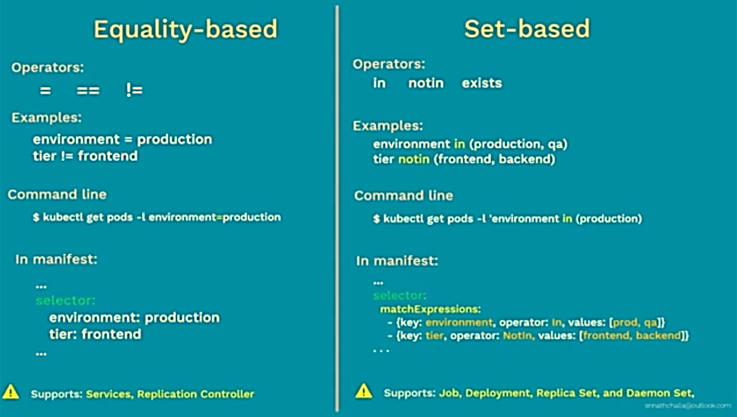

Slide 65
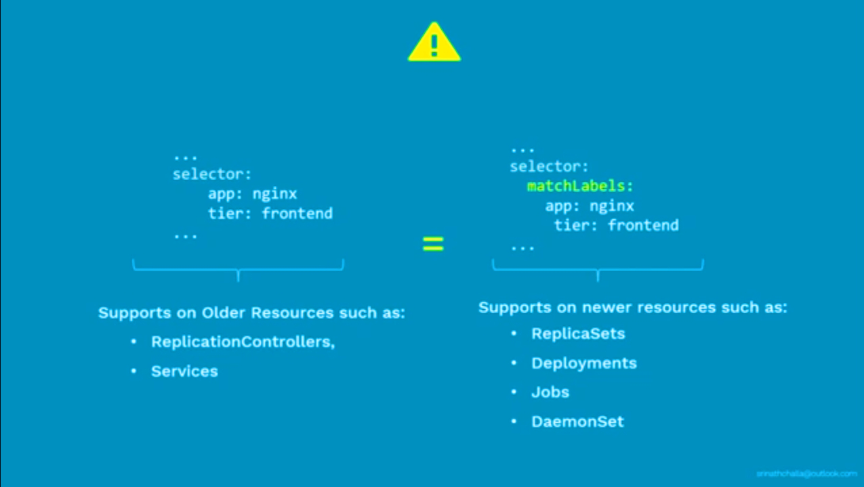

Slide 66
Label Selectors
K8s also support set-based selectors i.e match multiple values
$ kubectl get pods -l 'label in (value1, value2)‘
$ kubectl get pods -l 'env in (development, testing)‘
List pods matching multiple values
$ kubectl get pods -l environment=testing, tier=frontend

Slide 67
Node Selectors
One use case for selecting labels is to constrain the set of nodes onto which a pod can schedule i.e You can tell a pod to only be able to run on particular nodes
Generally such constraints are unnecessary, as the scheduler will automatically do a reasonable placement, but on certain circumstances we might need it
We can use labels to tag Nodes
You the nodes are tagged, you can use the Label Selectors to specify the pods run only of specific nodes
First we tag the node
Use nodeSelector to the pod configuration

Slide 68
Node Selectors – Example7: nodelabels.yml
kind: Pod
apiVersion: v1
metadata:
name: vi
labels:
env: development
spec:
containers:
- name: c00
image: ubuntu
command: ["/bin/bash", "-c", "while true; do echo Hello; sleep 5 ; done"]
nodeSelector: # specifies which node to run the pod
hardware: t2-medium

Slide 69
$ kubectl apply -f nodelabels.yml
$ kubectl describe node <nodename>
$ kubectl get pods
- you would see the status for this new pod is pending, as there are no nodes which has the label
$ kubectl describe pods <podname>
Add a label to an node
$ kubectl label nodes <nodename> <labelkey>=<value>
$ kubectl label nodes minikube hardware=t2-medium
$ kubectl describe node <nodename>
$ kubectl get pods

